Slide 1
IBM Rational Performance Test

Slide 2





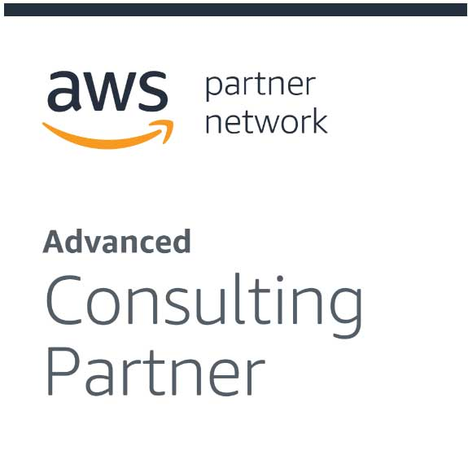


About CloudThat​
9+
350k+
100+
100+
350+
Years in Business
Professional Trained
Corporates Trained
Projects Delivered
Cloud Certifications
Leader in Training and Consulting on Cloud, Security, AI/ML, IoT and DevOps
Trained over 350k+ professionals across technologies and geographies
Proven track record of training delivery for all stages of employee lifecycle
Strong team of 125+ certified cloud experts with
industry consulting experience
Robust consulting division brings industry prospective to training delivery
Page 2

Slide 3
PREREQUISITES:
Basic understanding of software testing concepts
Familiarity with programming concepts
Understanding of web technologies
Database knowledge
Experience with test automation tools
Familiarity with version control systems
Basic understanding of Continuous Integration/Continuous Deployment (CI/CD)
Knowledge of GUI testing concepts (for RFT)
Understanding of load testing concepts and performance metrics (for RPT)
Knowledge of service-oriented architecture (SOA) concepts (for RIT)
Familiarity with managing virtual services and environments (for RTCP)

Slide 4
Rational Performance Tester Licence Configuration

Slide 5
Runtime License Runtime license is used during performance testing, not recording or developing. The most common on is the Virtual Test Pack used to simulate virual Concurrent user numbers

Slide 7
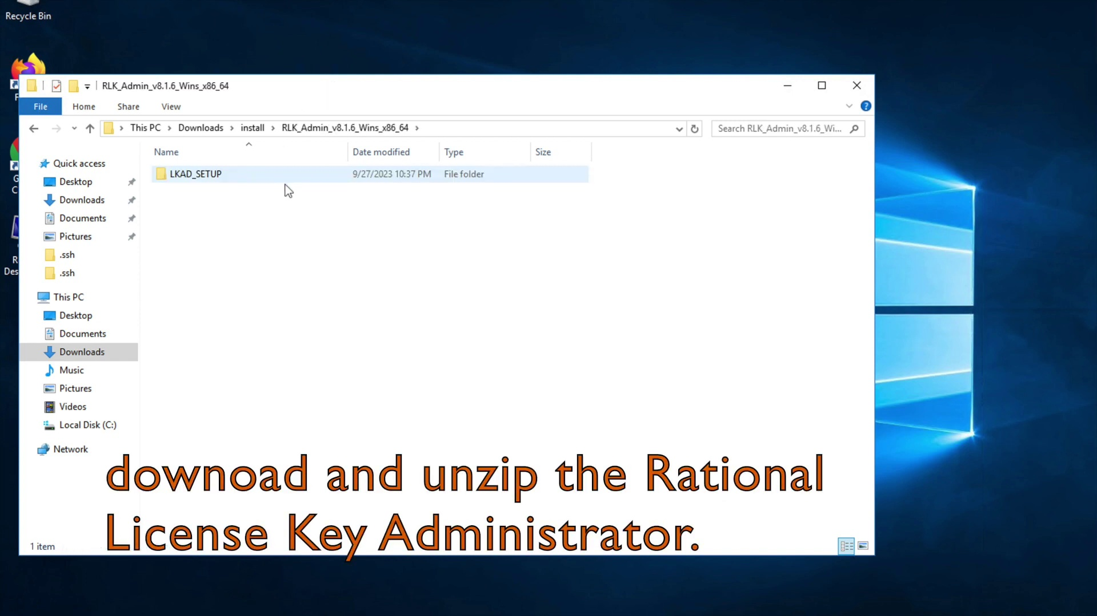

Slide 8
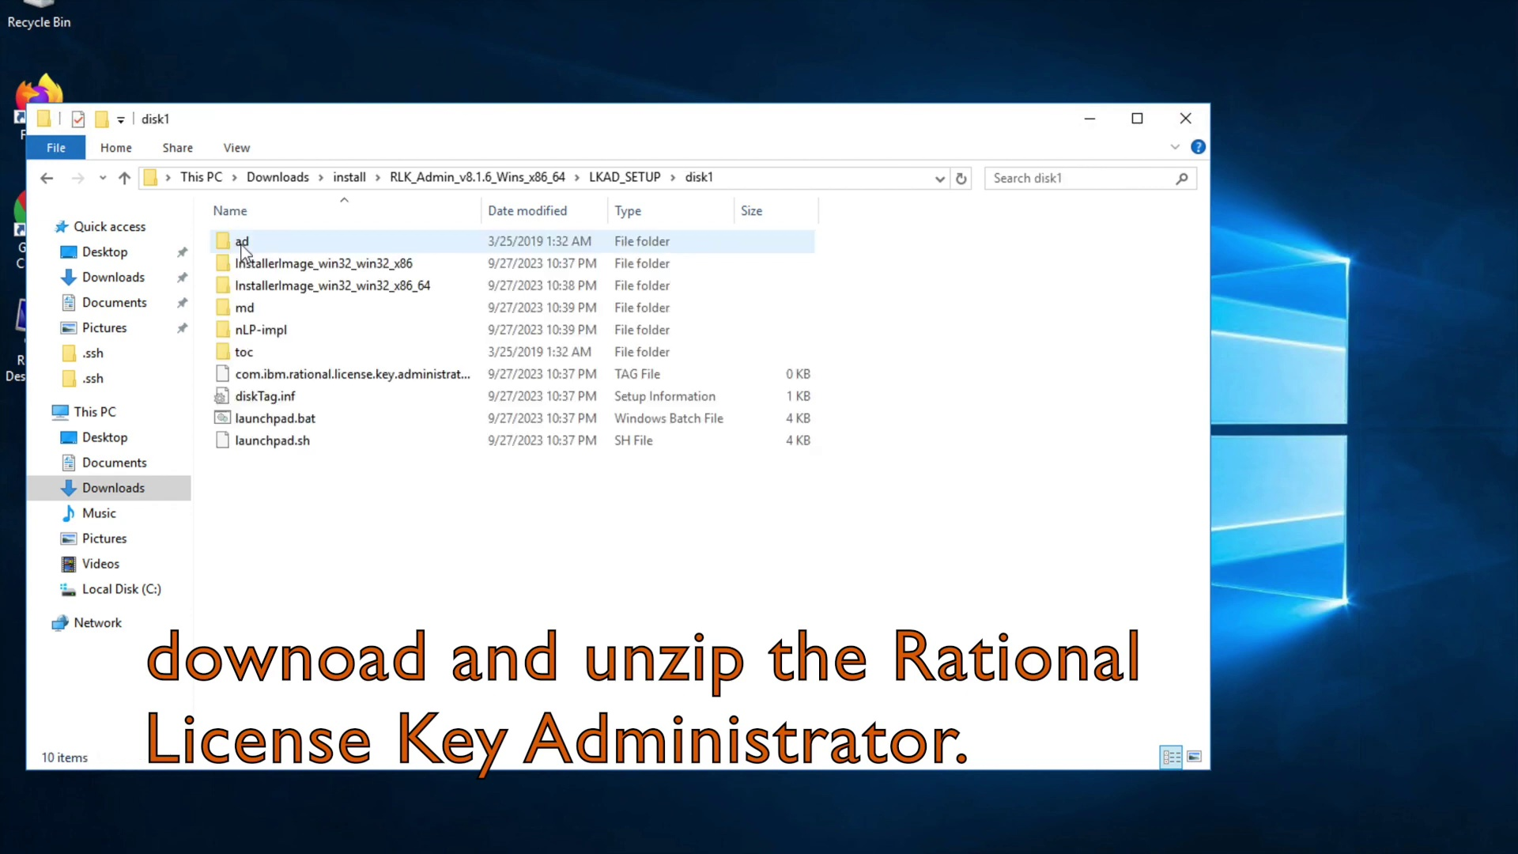

Slide 9
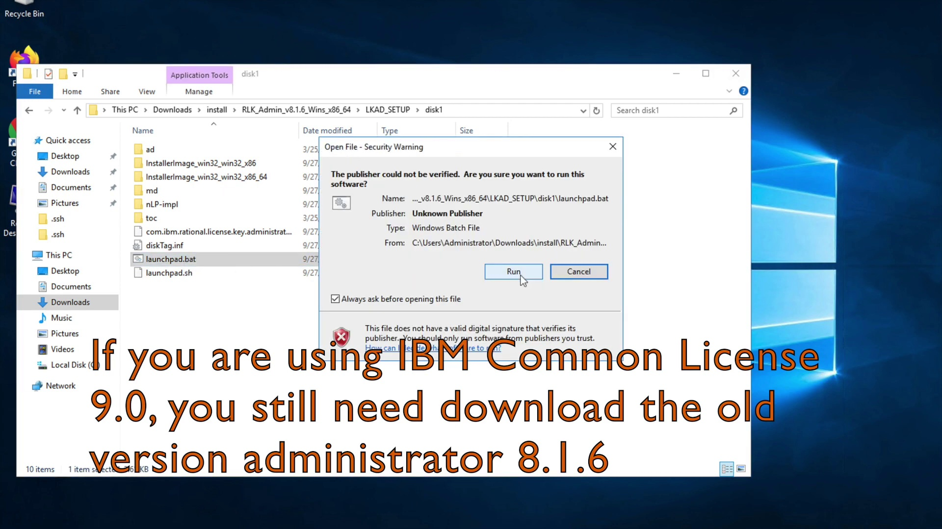

Slide 10
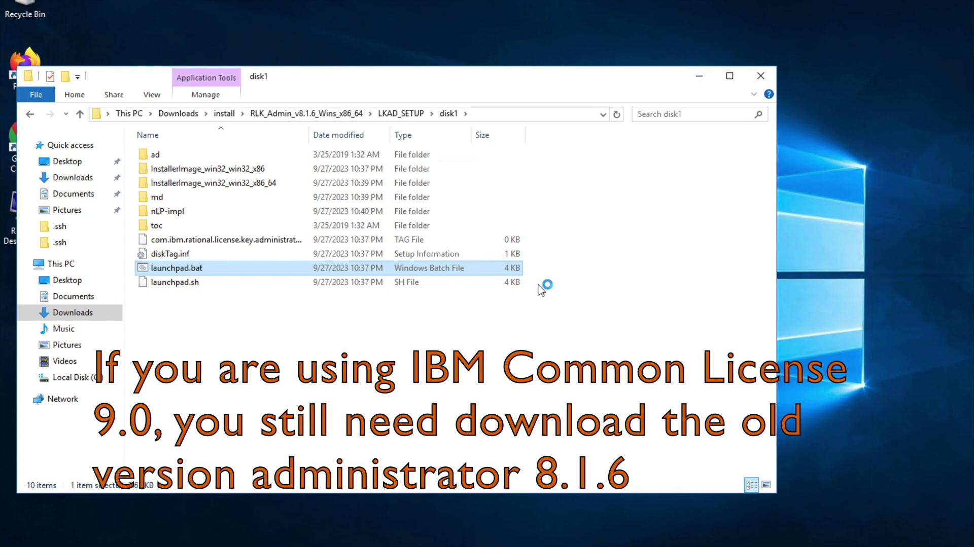

Slide 11
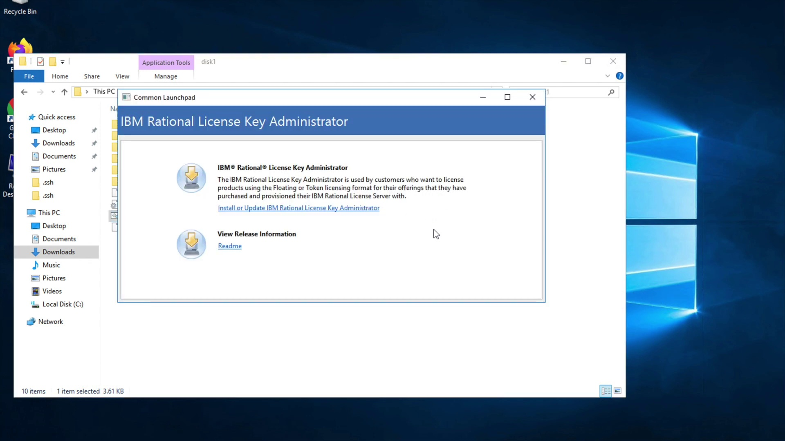

Slide 12
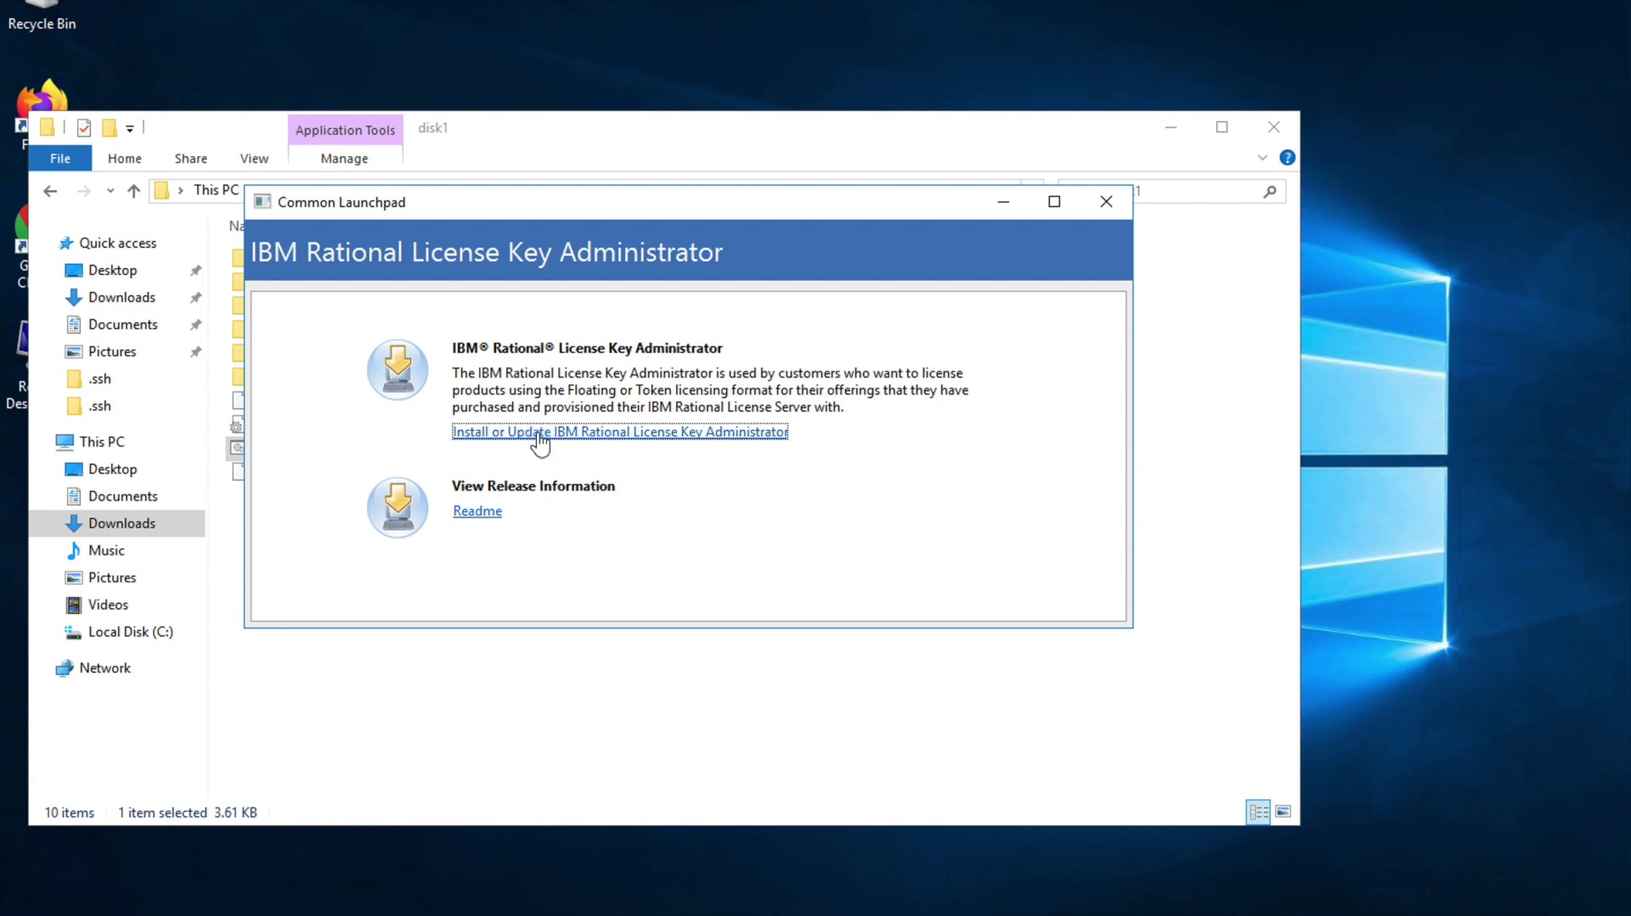

Slide 13
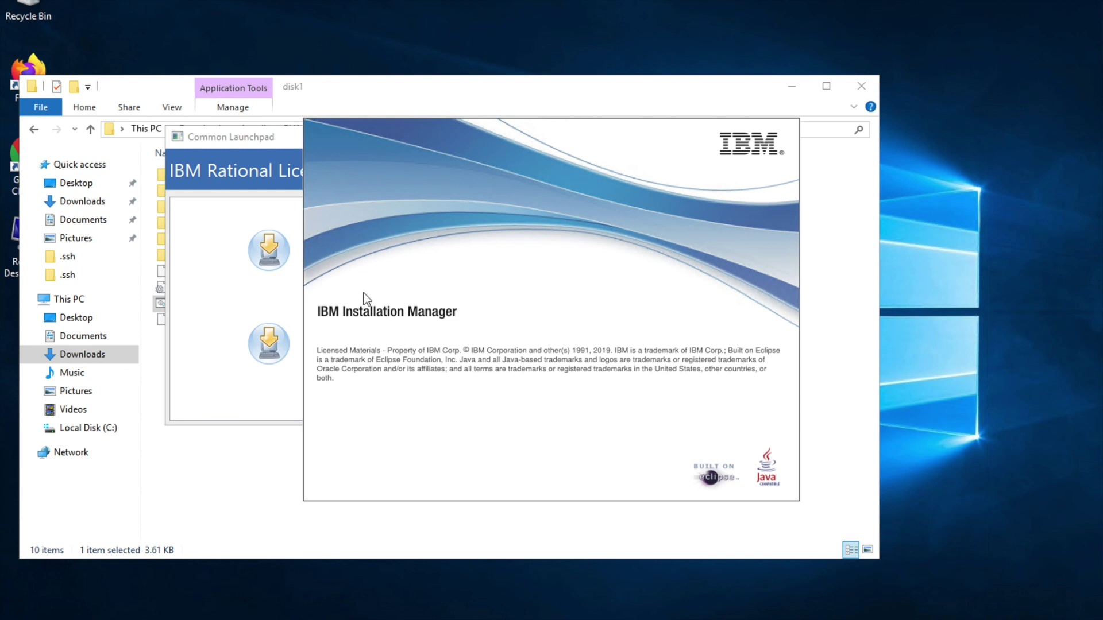

Slide 14


Slide 15


Slide 16
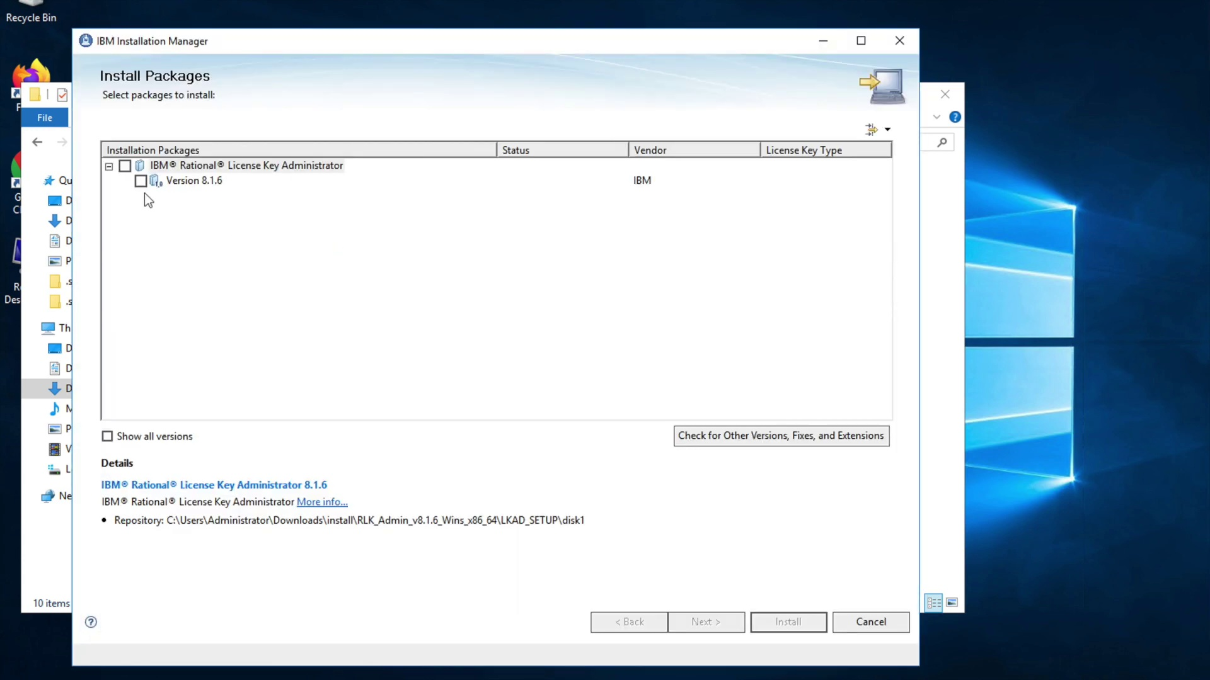

Slide 17
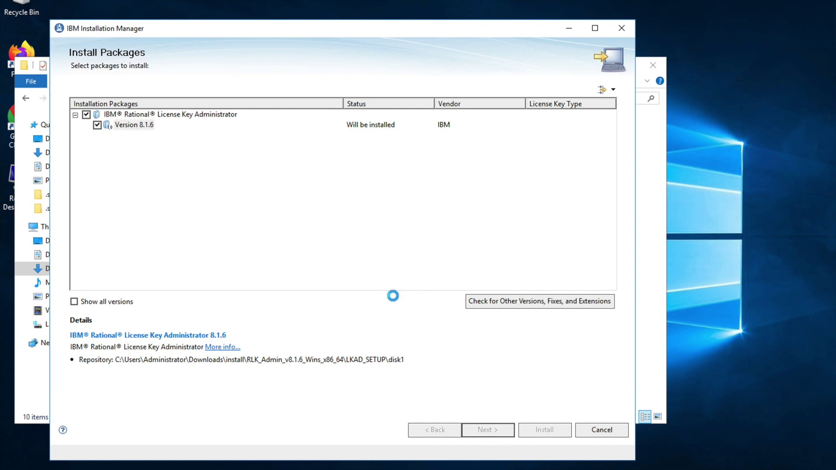

Slide 18
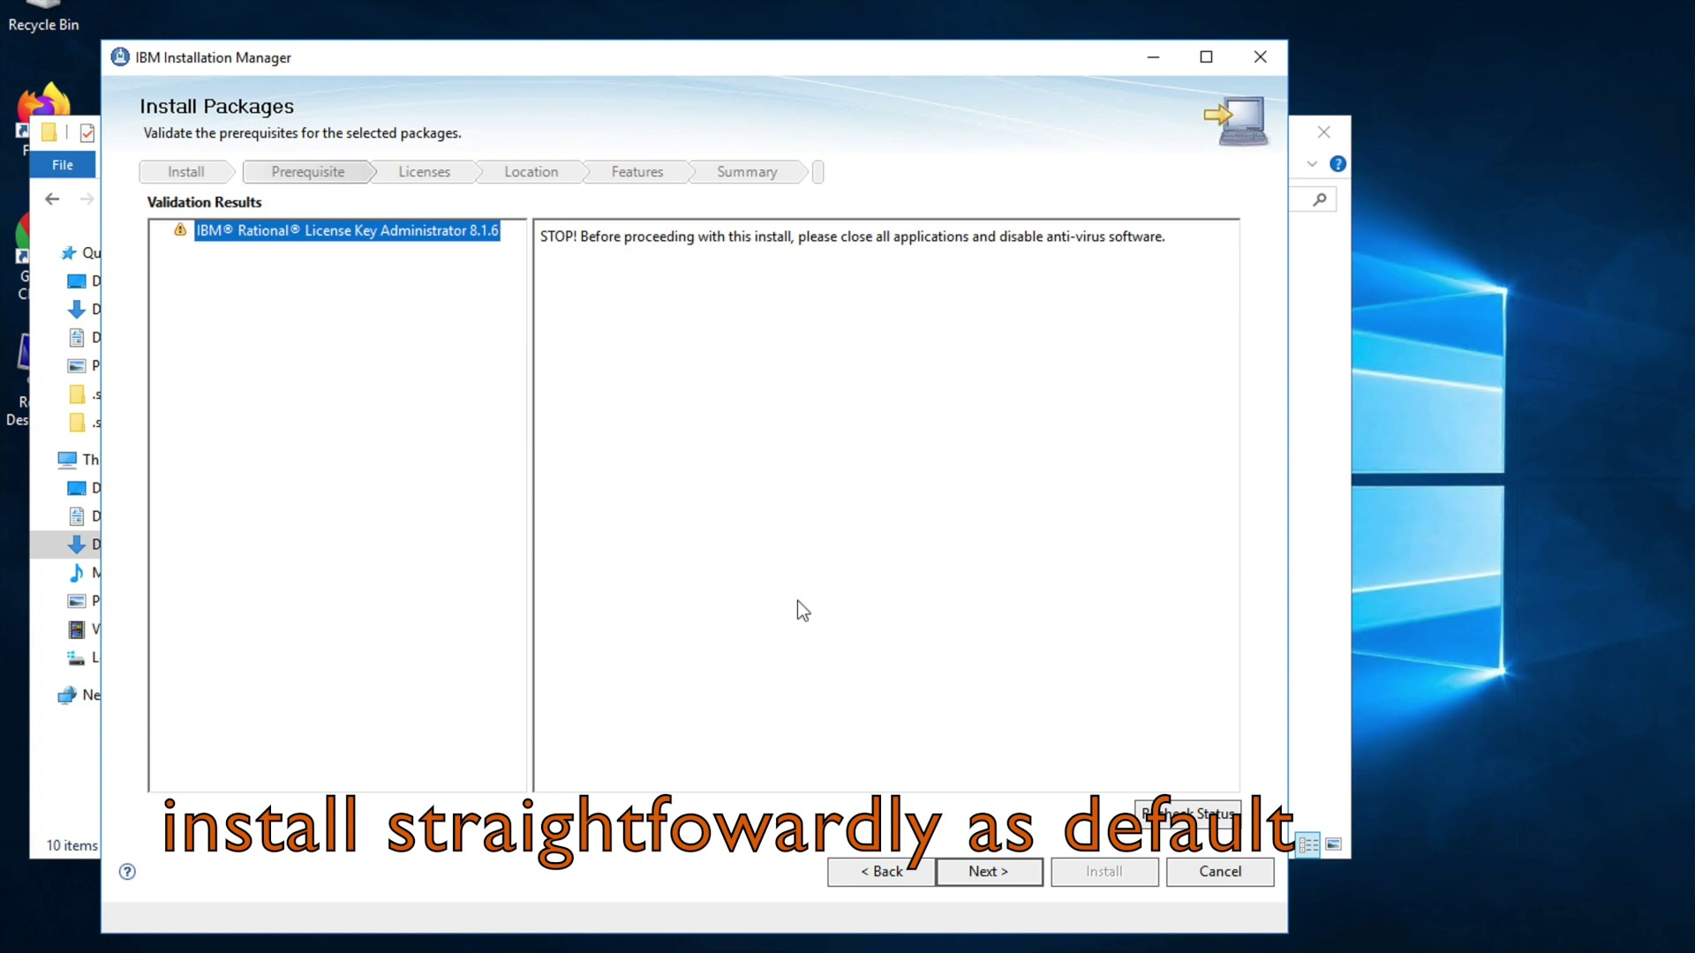

Slide 19
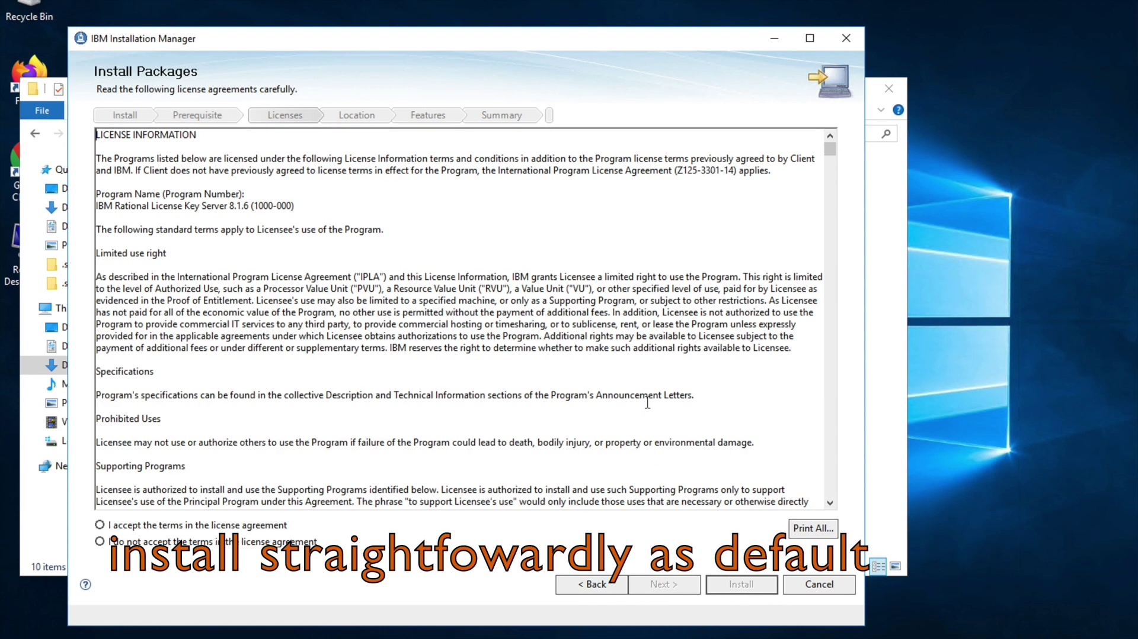

Slide 20


Slide 21
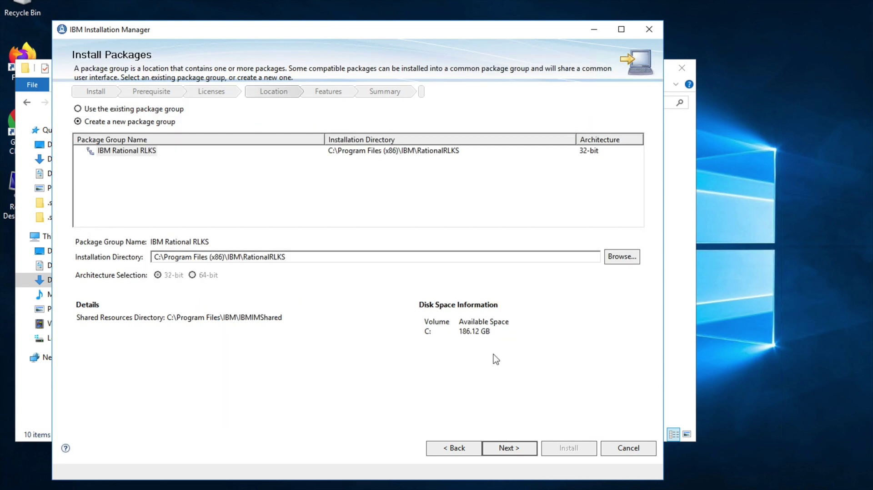

Slide 22
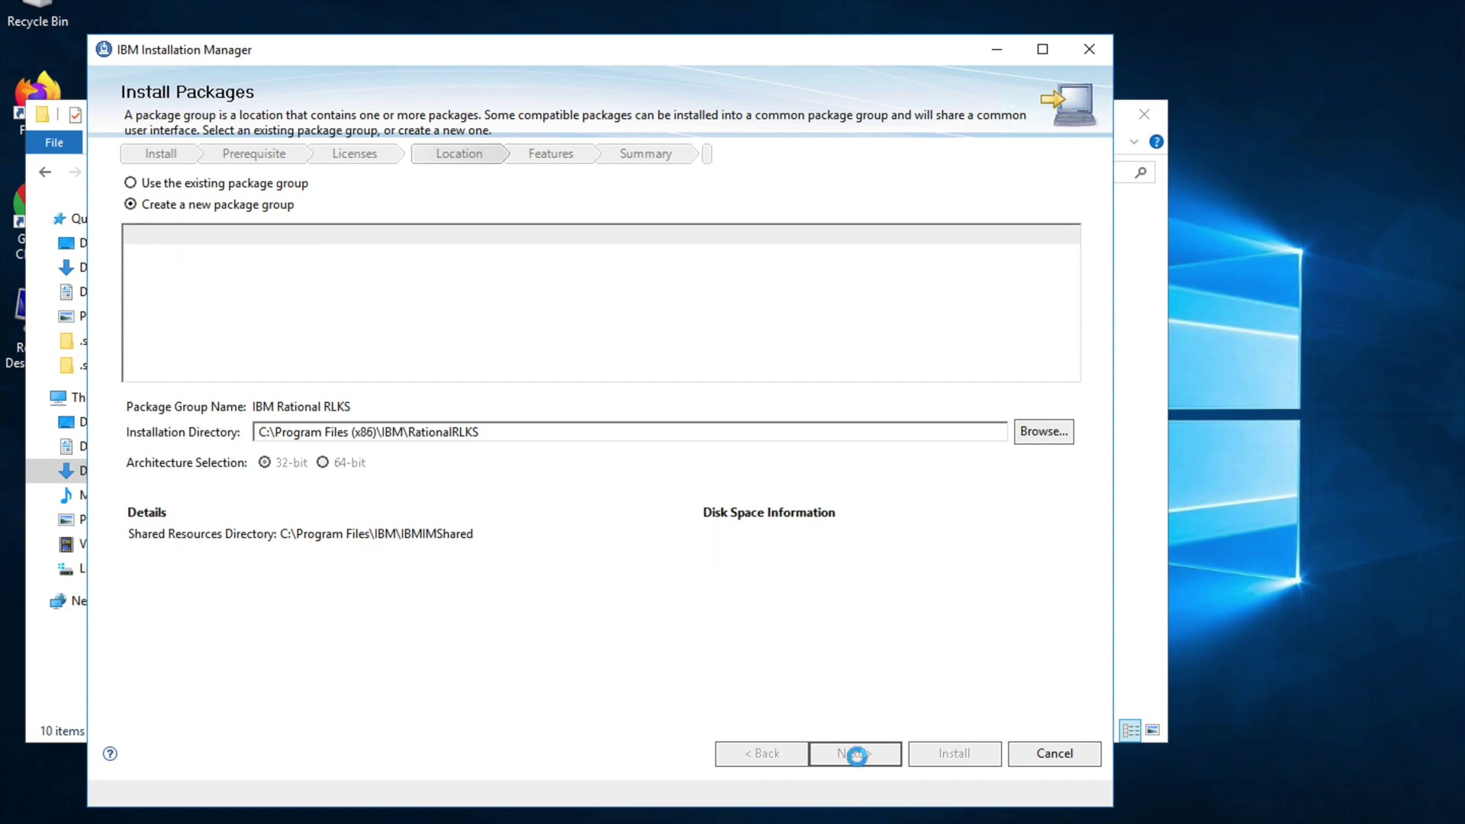

Slide 23
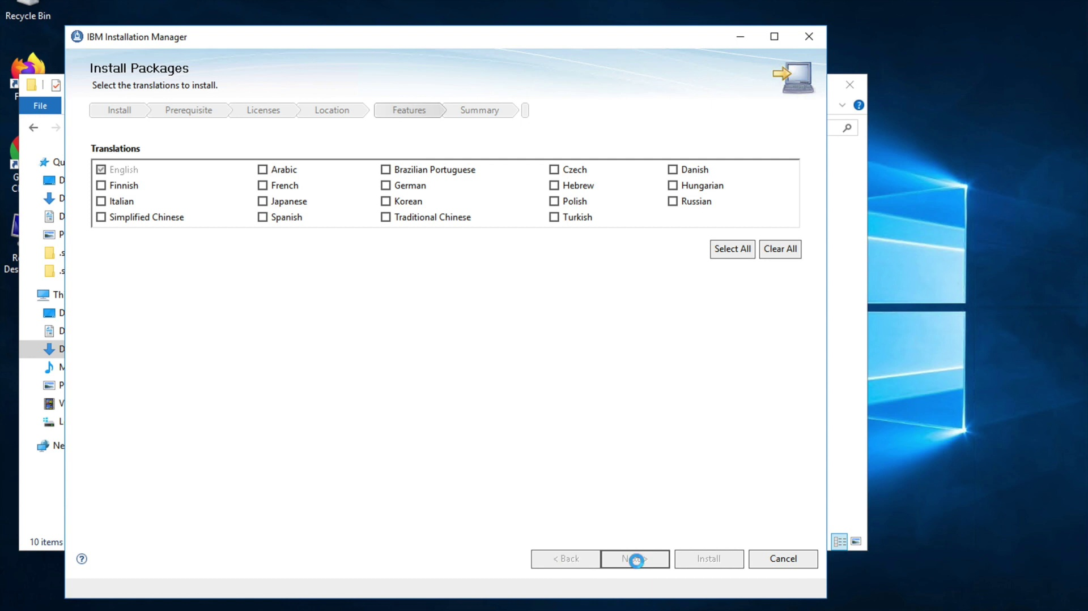

Slide 24
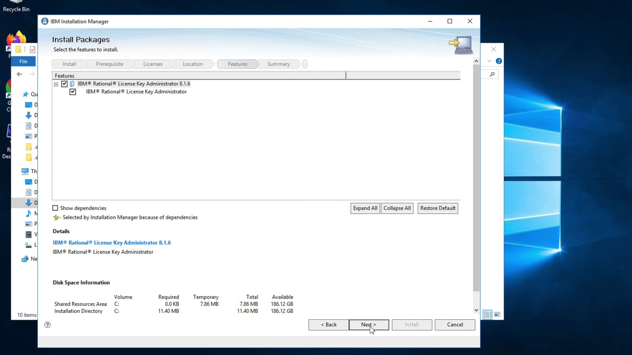

Slide 25
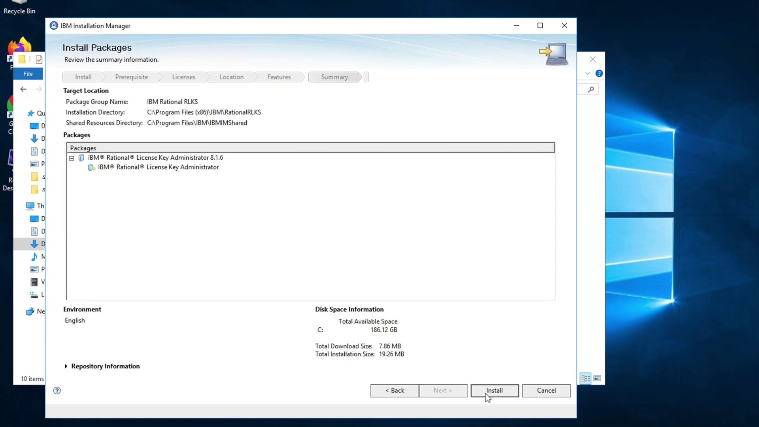

Slide 26
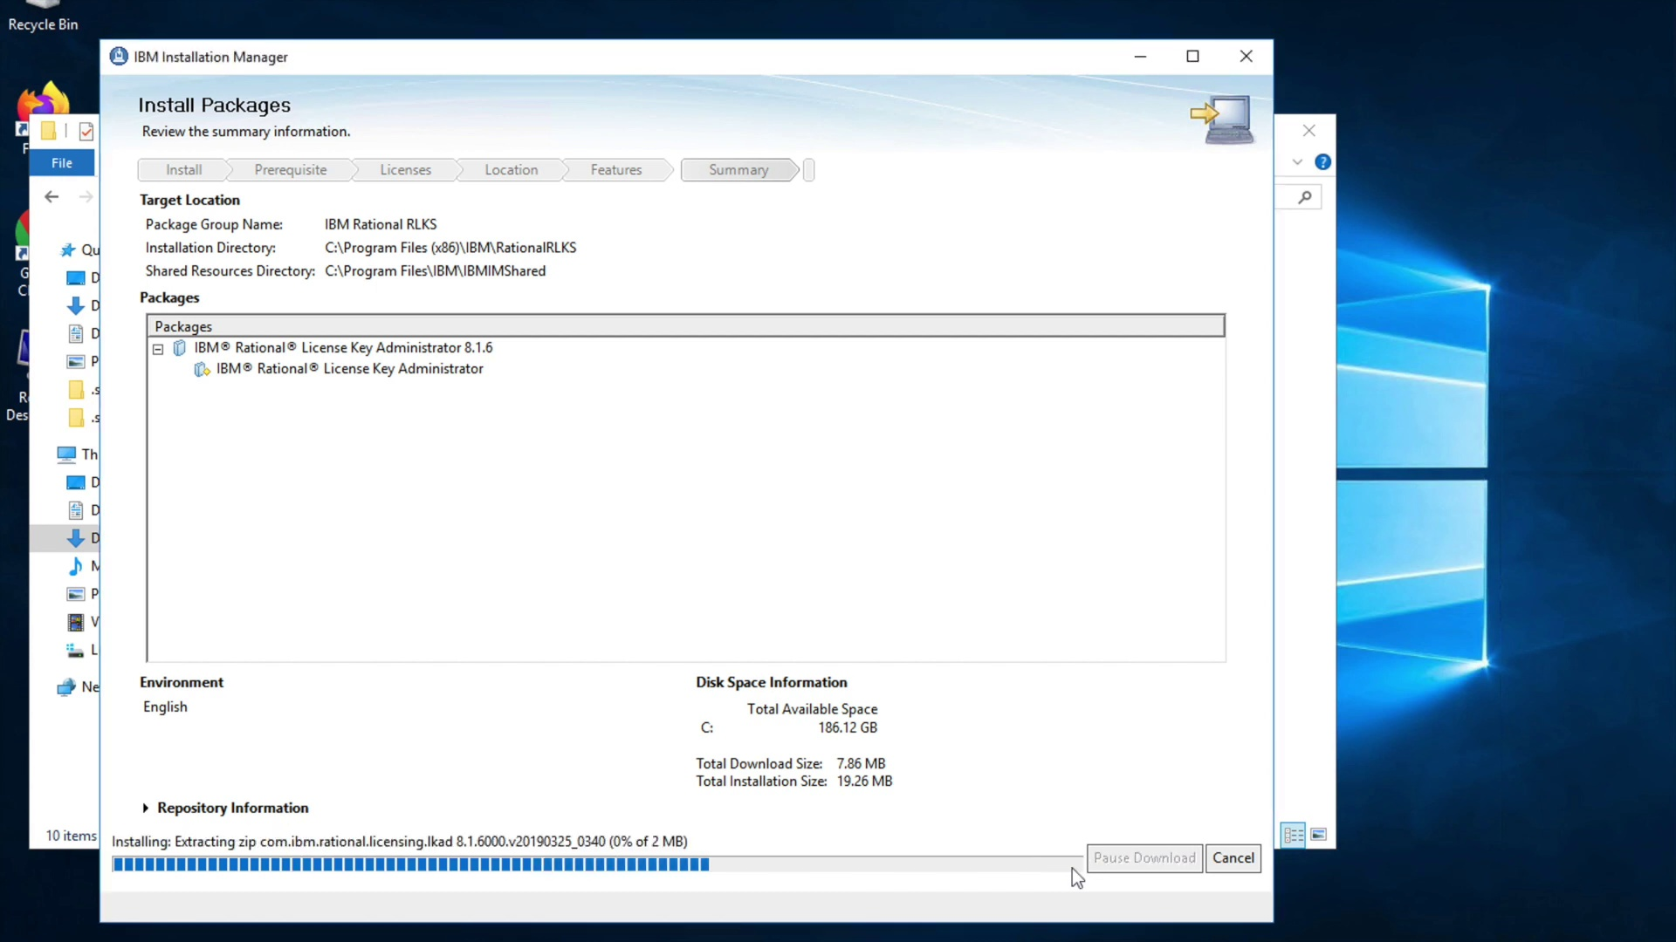

Slide 27
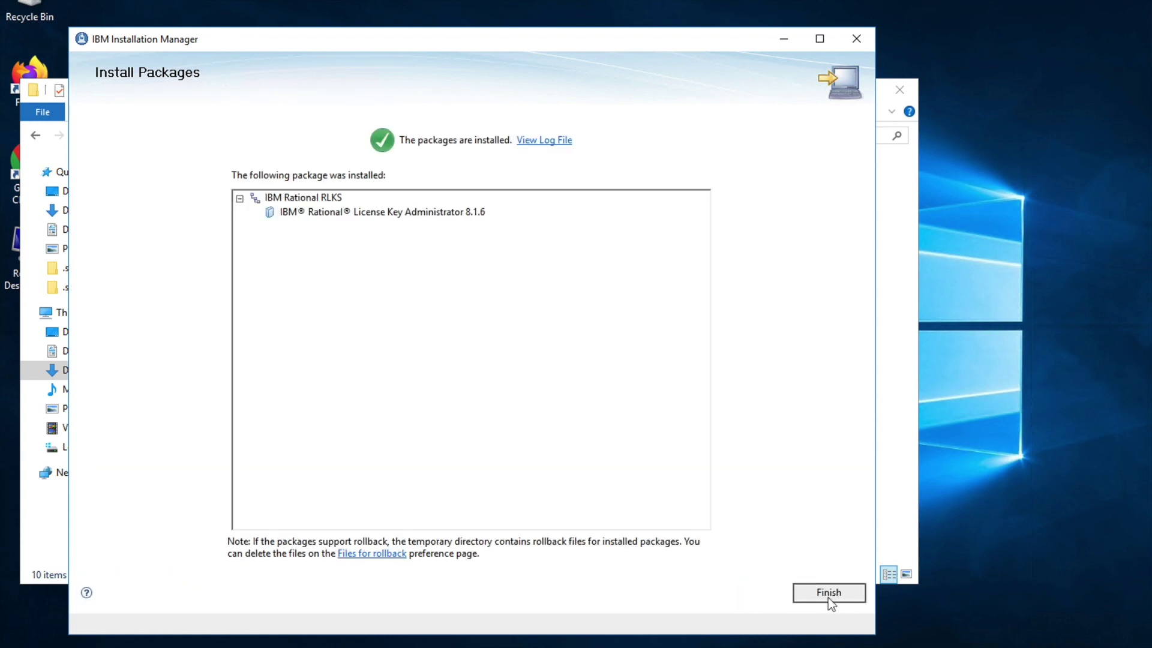

Slide 28


Slide 29
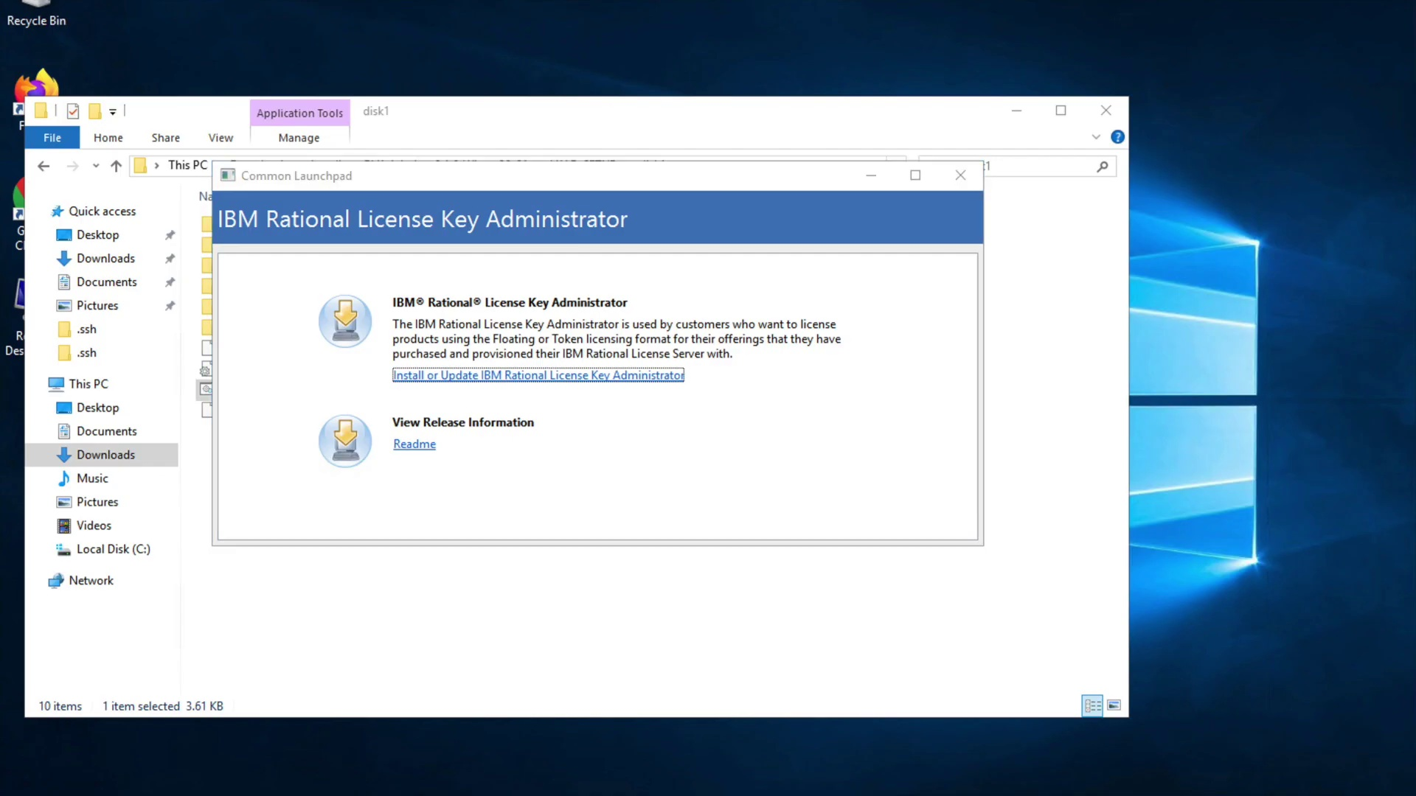

Slide 30
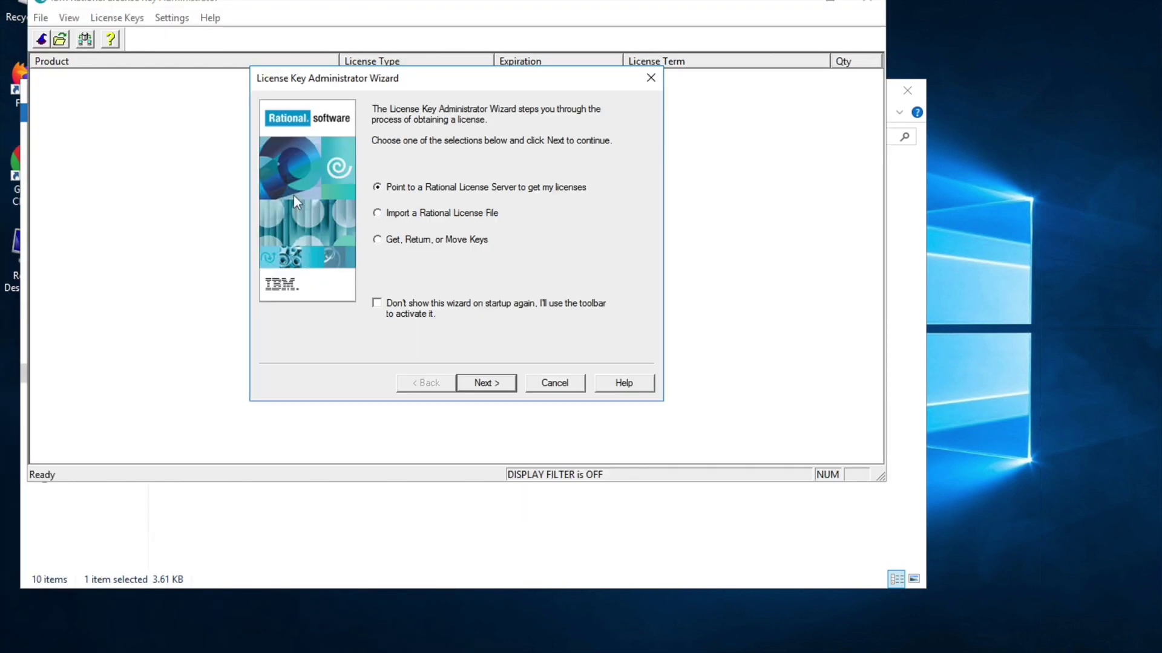

Slide 31


Slide 32
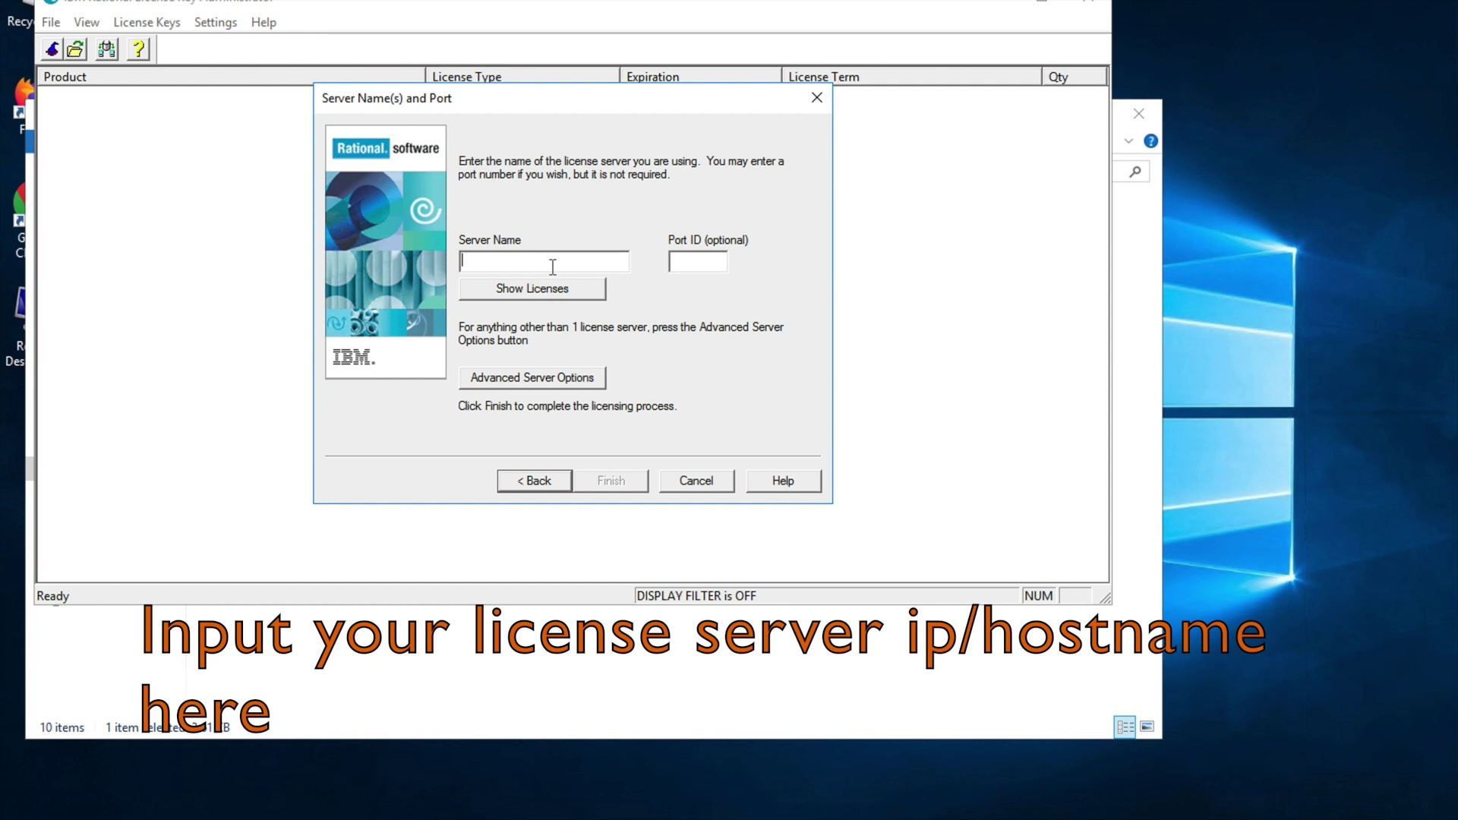

Slide 33
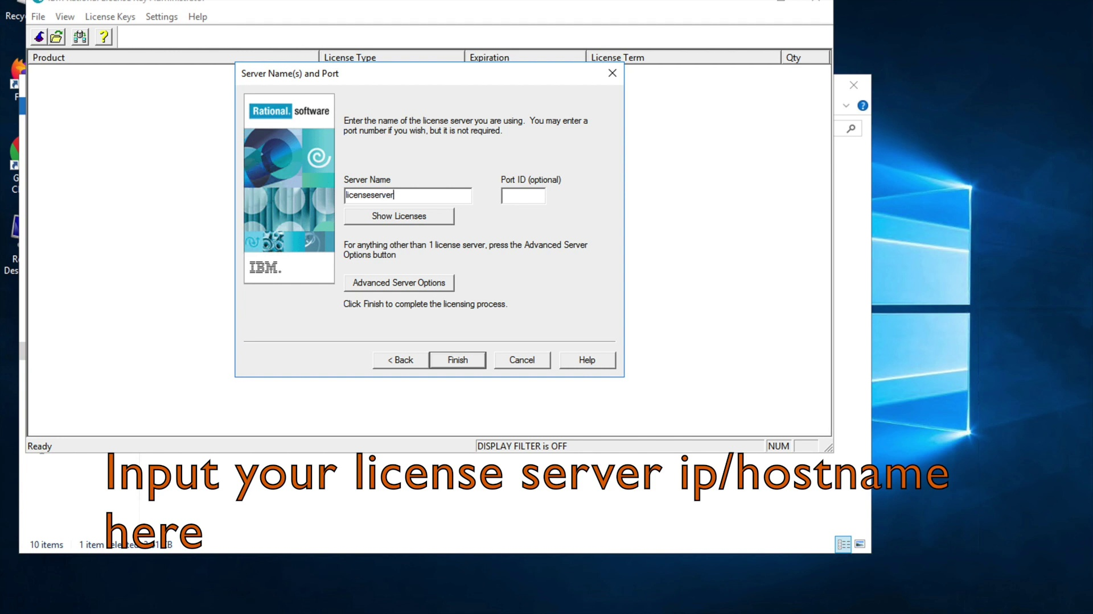

Slide 34


Slide 35


Slide 36


Slide 37
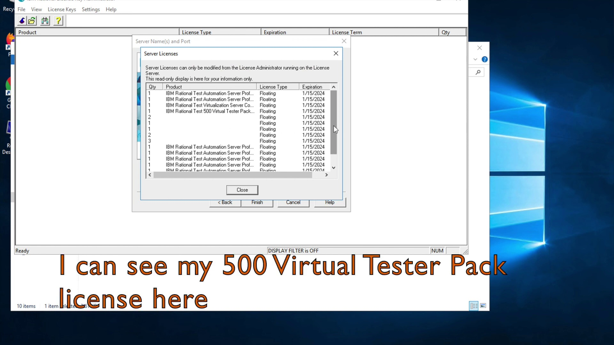

Slide 38


Slide 39


Slide 40


Slide 41
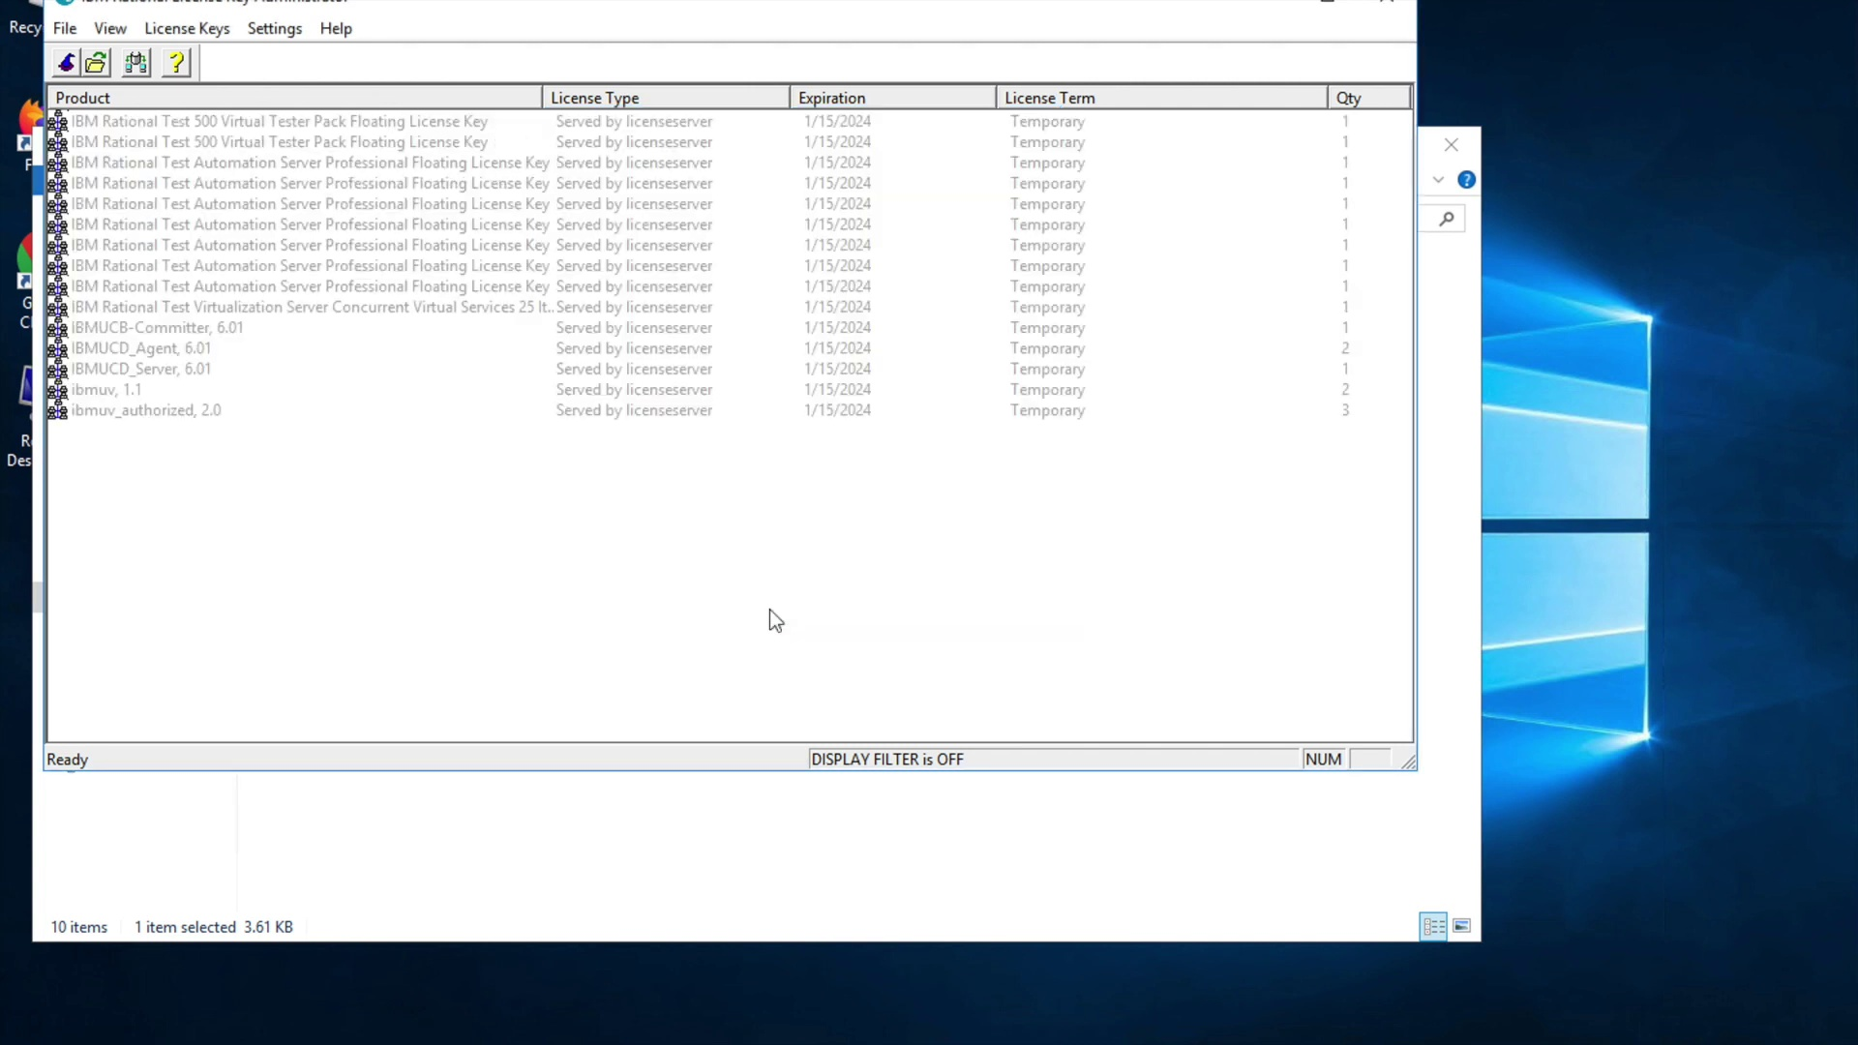

Slide 42
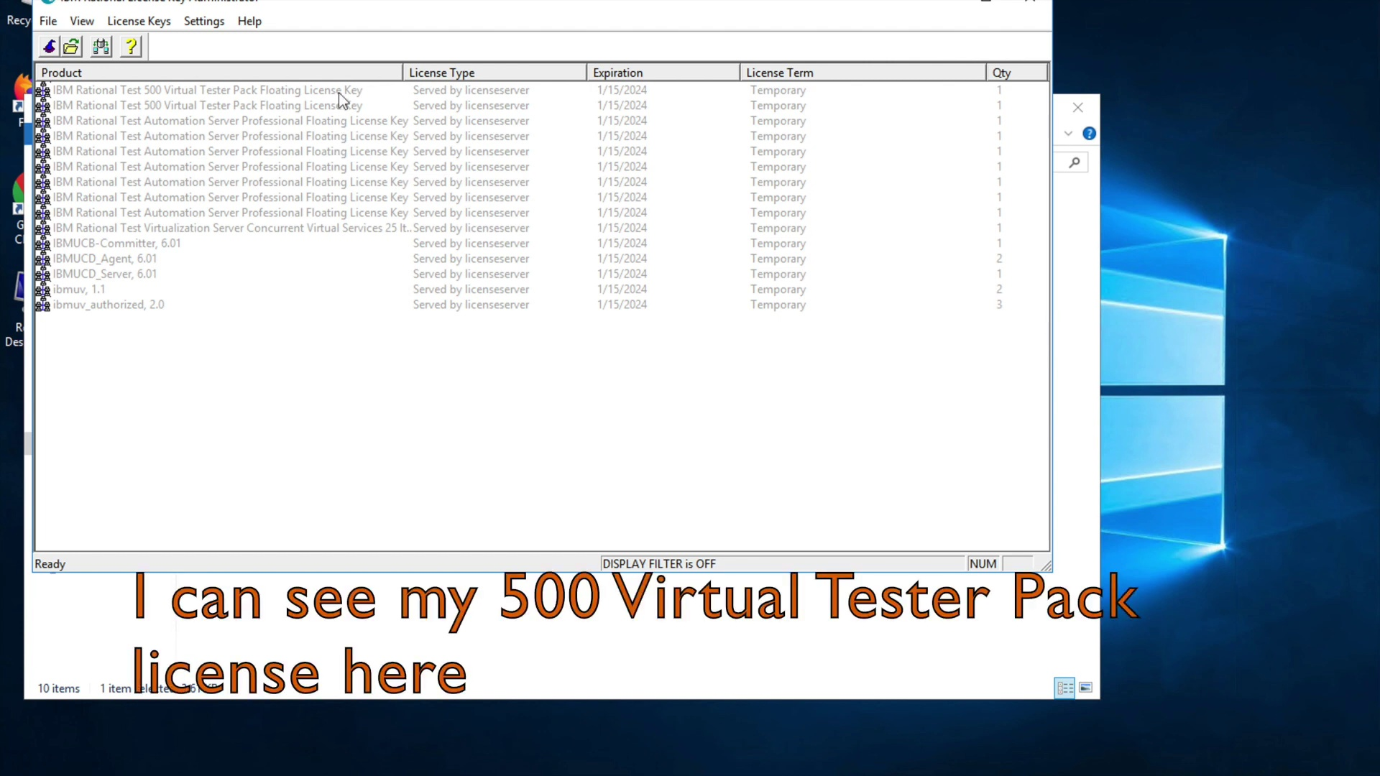

Slide 43
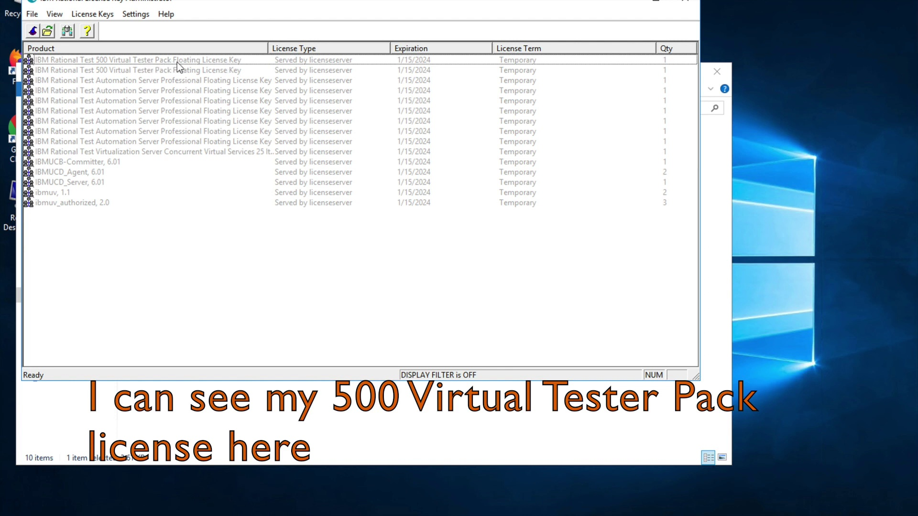

Slide 44
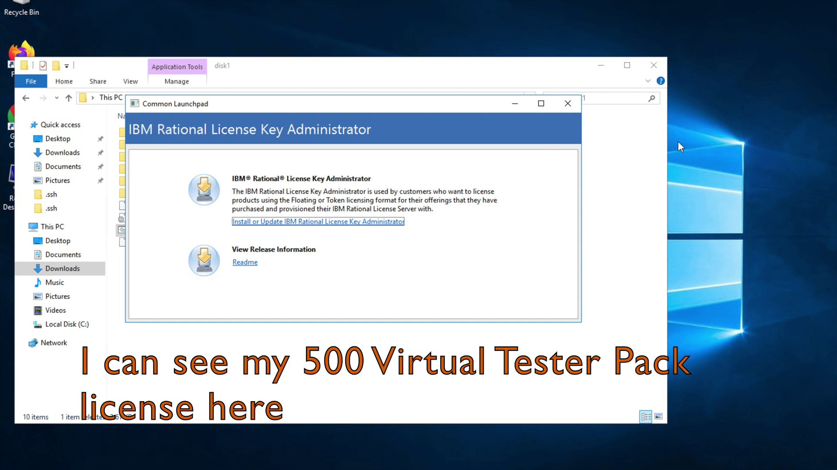

Slide 45


Slide 46
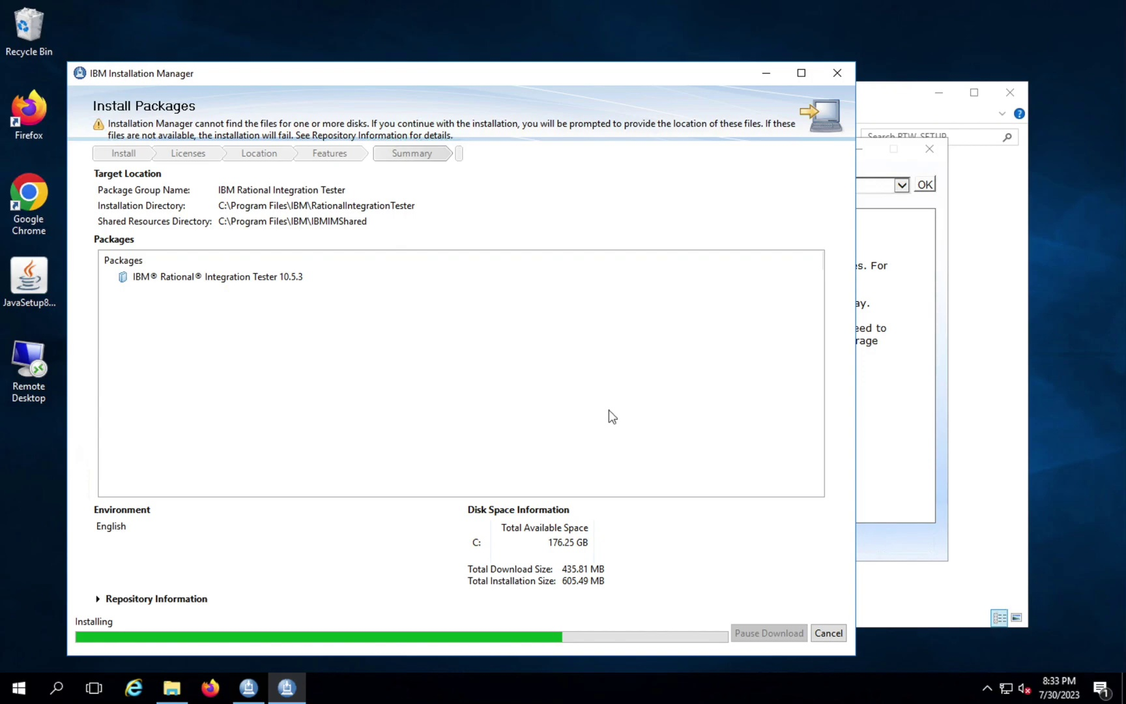

Slide 47
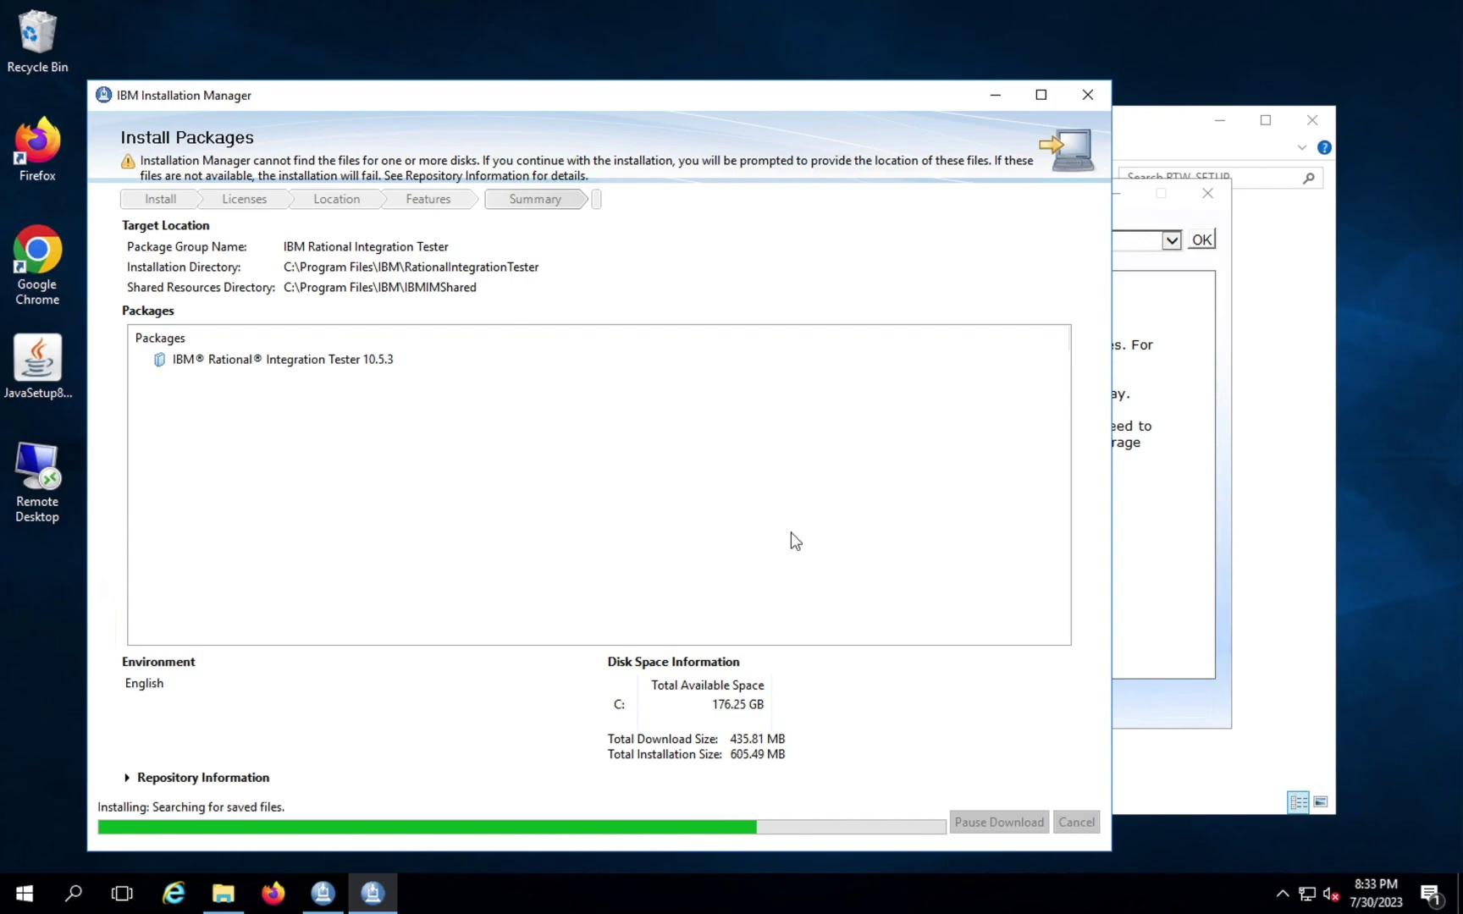

Slide 48
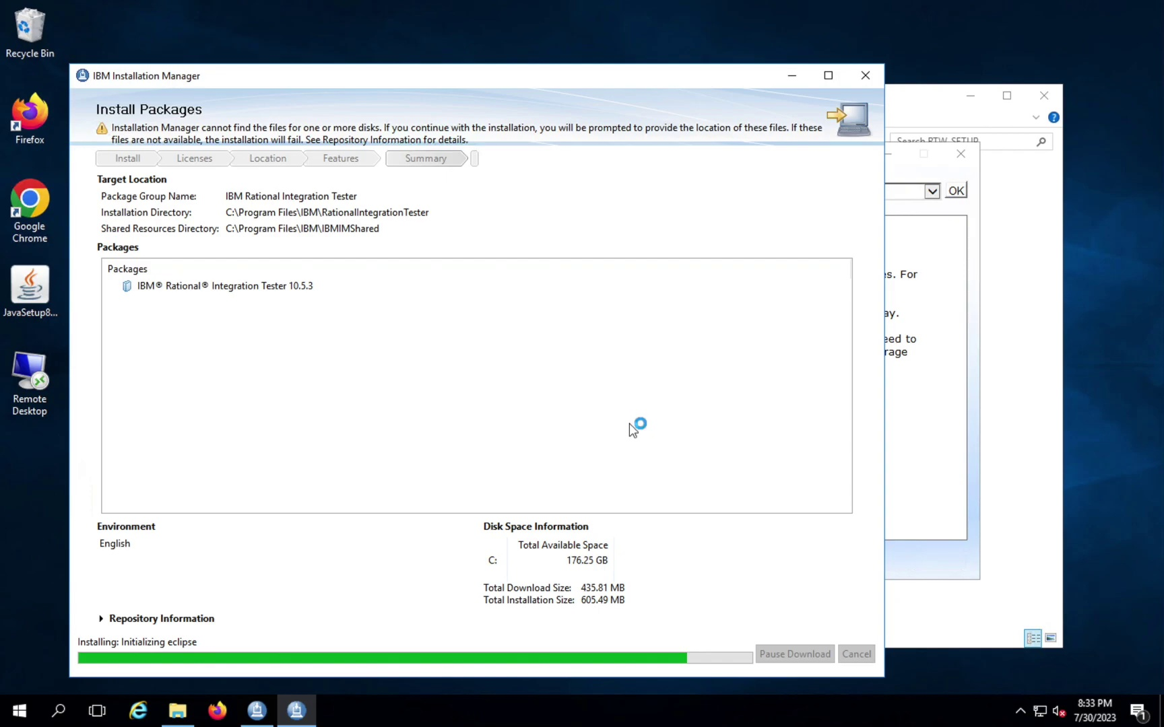

Slide 49
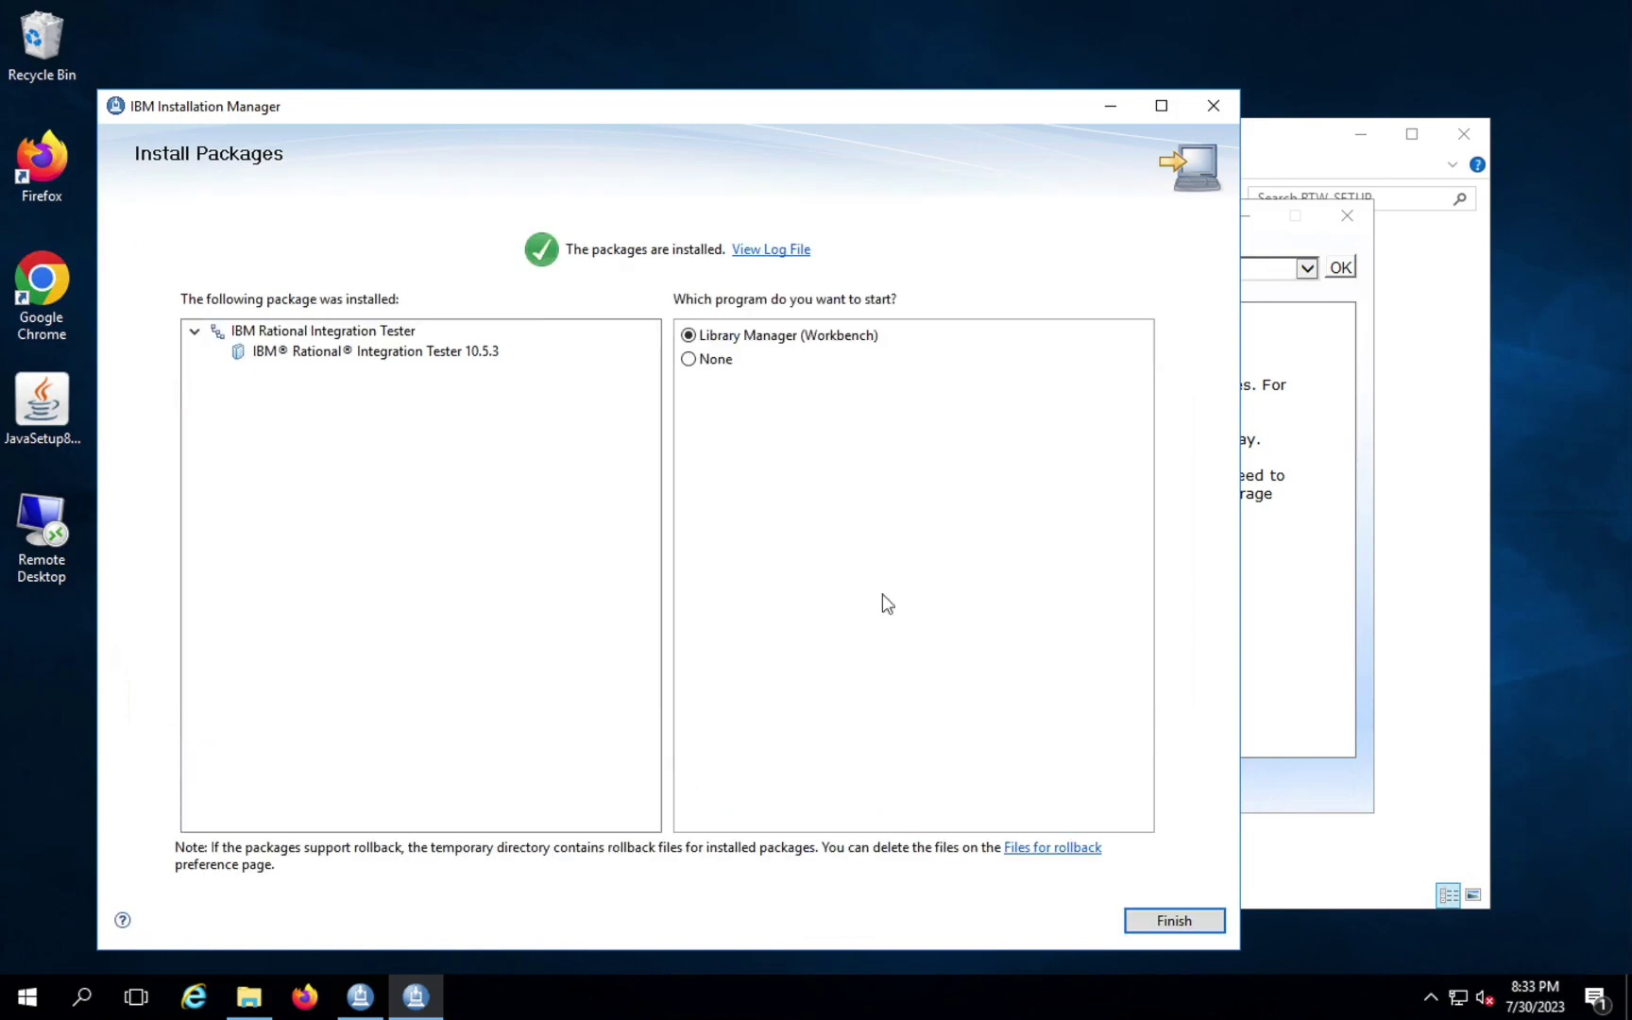

Slide 50


Slide 51
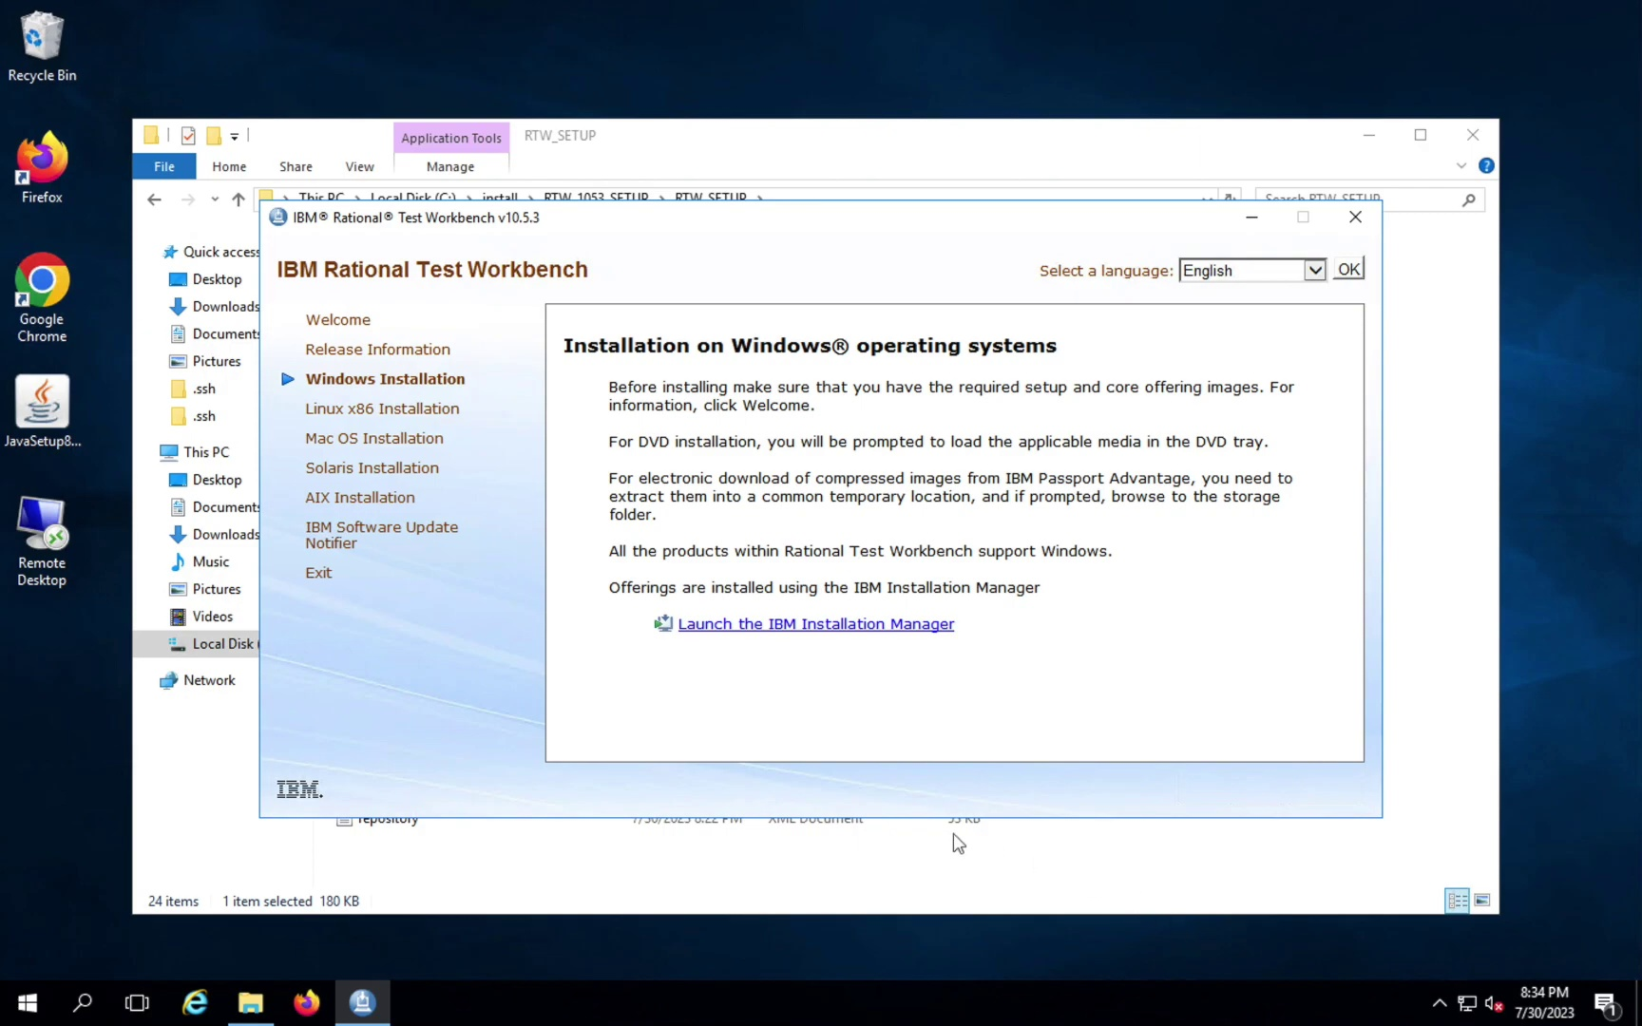

Slide 52
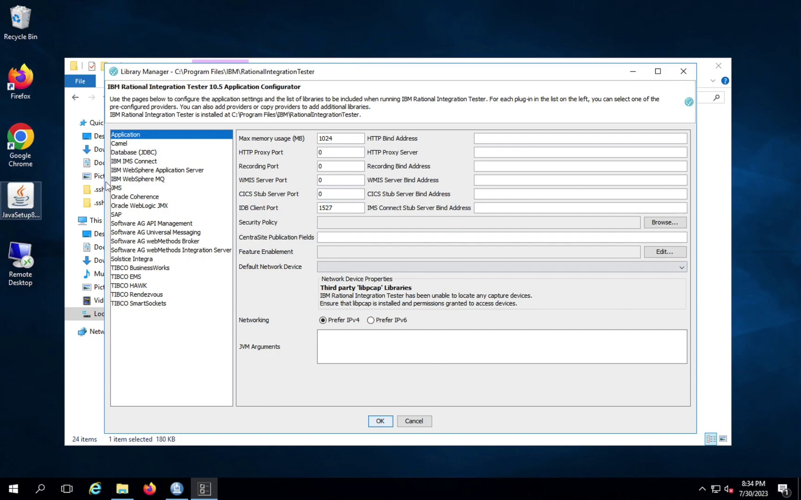

Slide 53
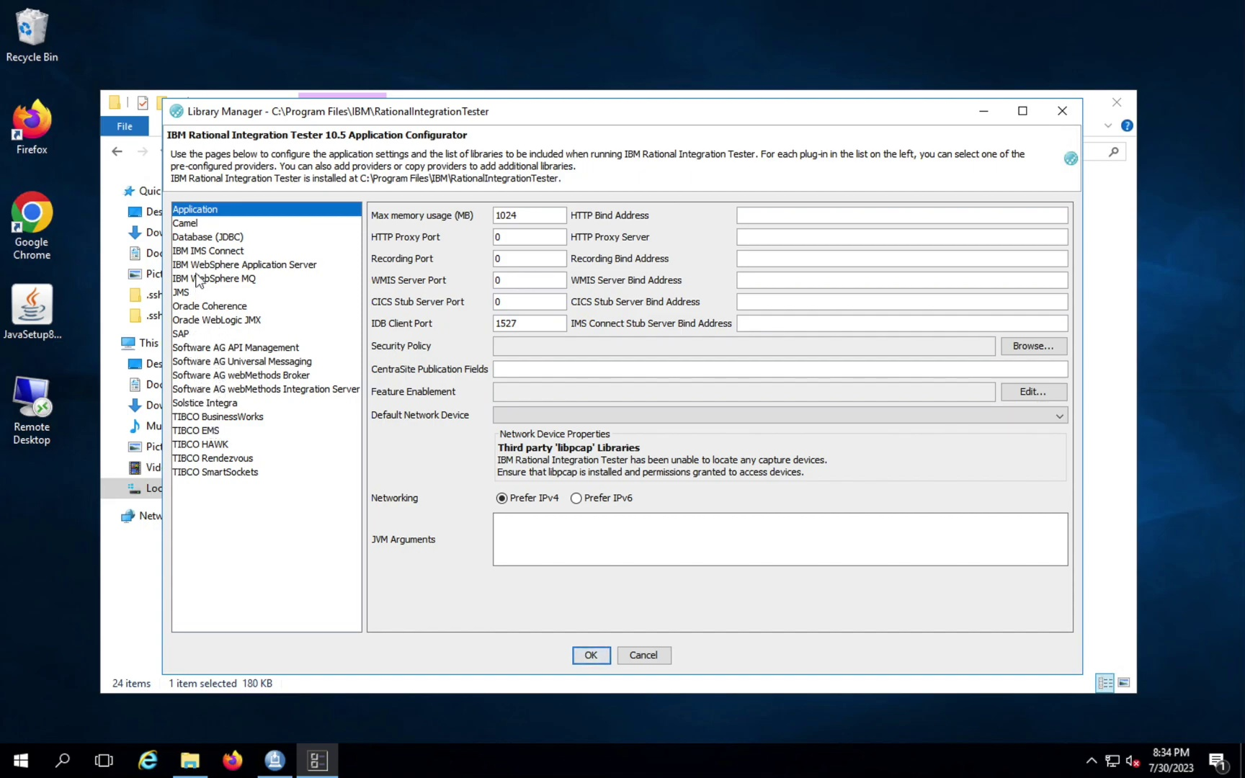

Slide 54


Slide 55


Slide 56


Slide 57
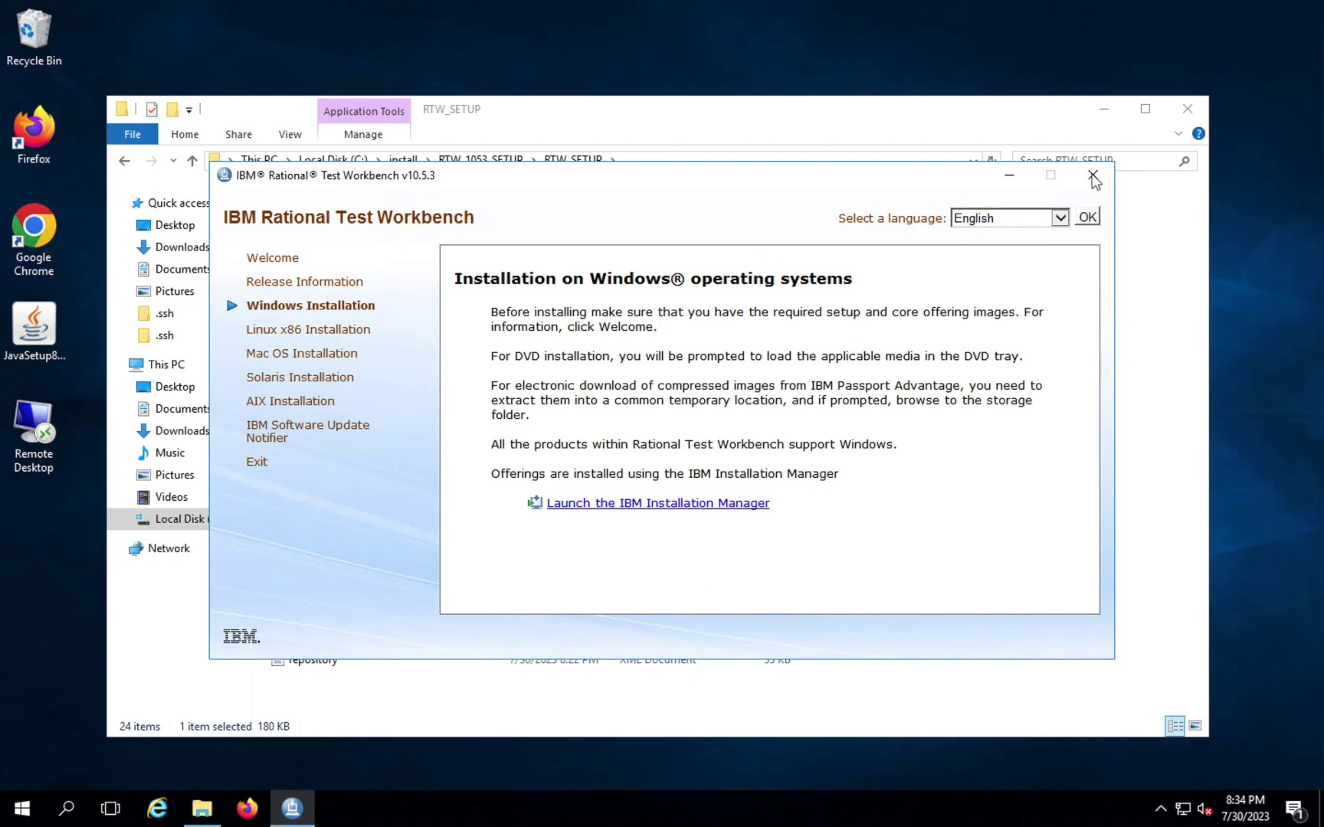

Slide 58
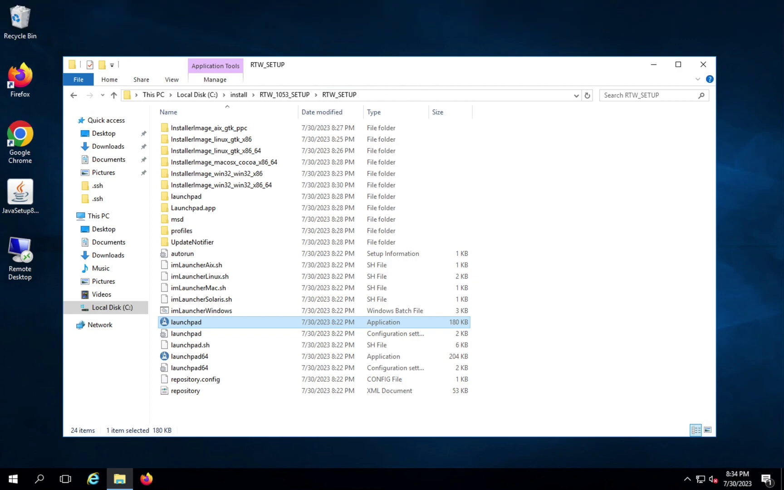

Slide 61
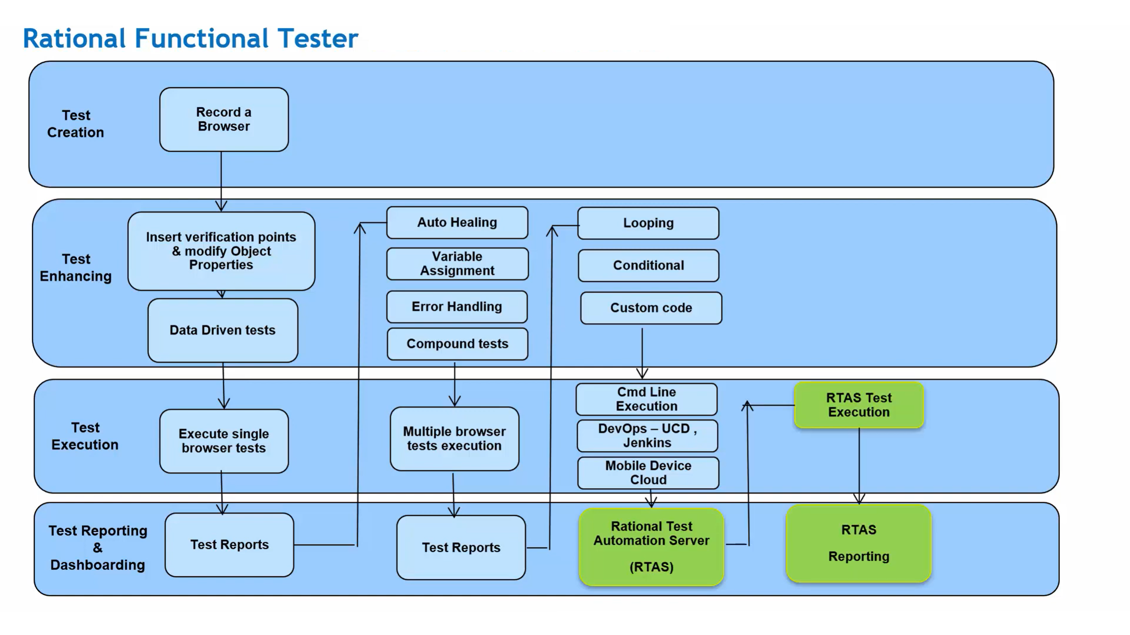

Slide 62
Questions ???

